Slide 1
One Door Away
Human-Cloud Systems Laboratory
School of Science and Engineering
The Chinese University of Hong Kong, Shenzhen

Slide 2
1. Core mechanics
Notes:
3. HCSLab.png

Slide 3
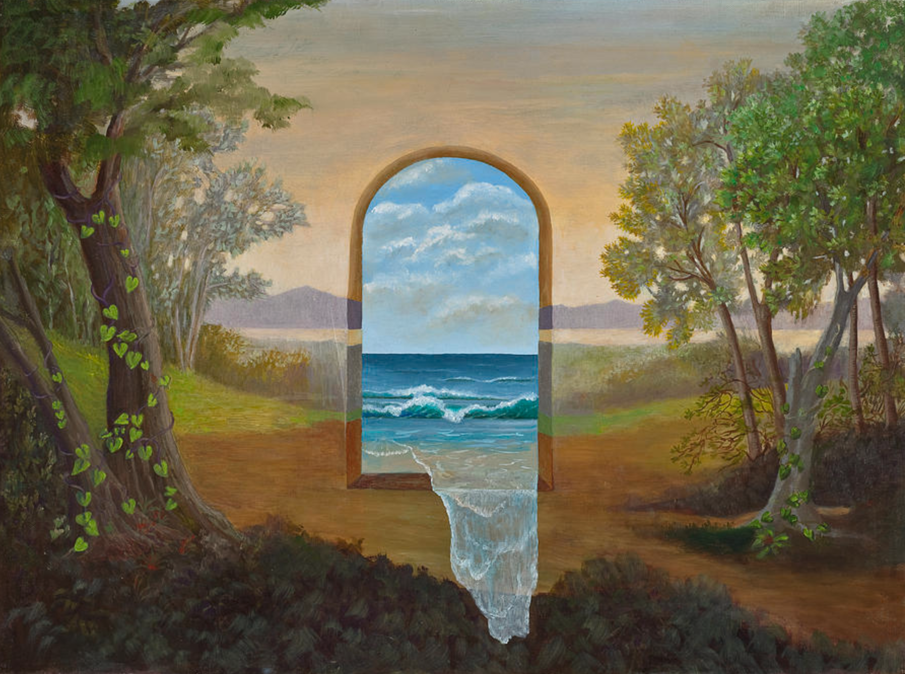
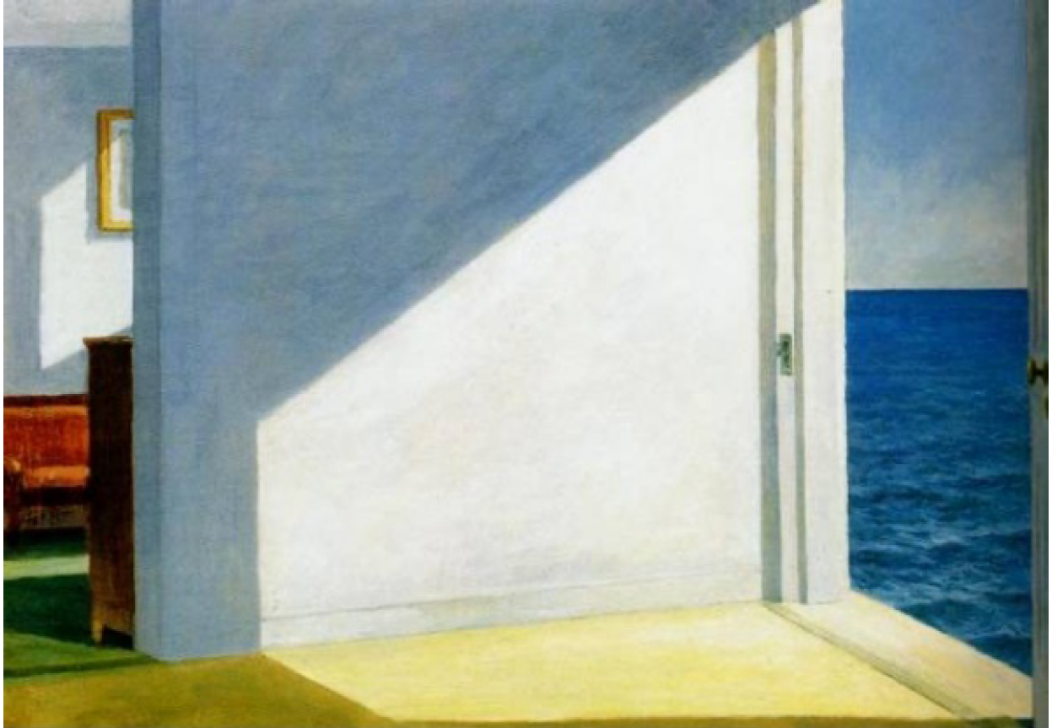
What is “One Door Away”?
One door away from the Sea
Rooms by the Sea
One Door Away…..
a Portal !!!
Notes:
3. HCSLab.png

Slide 4

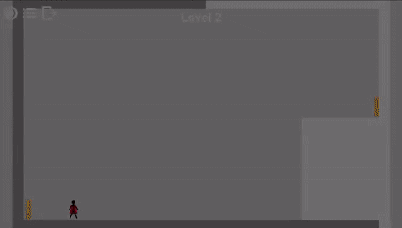
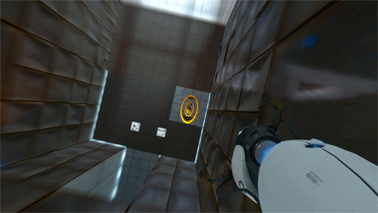
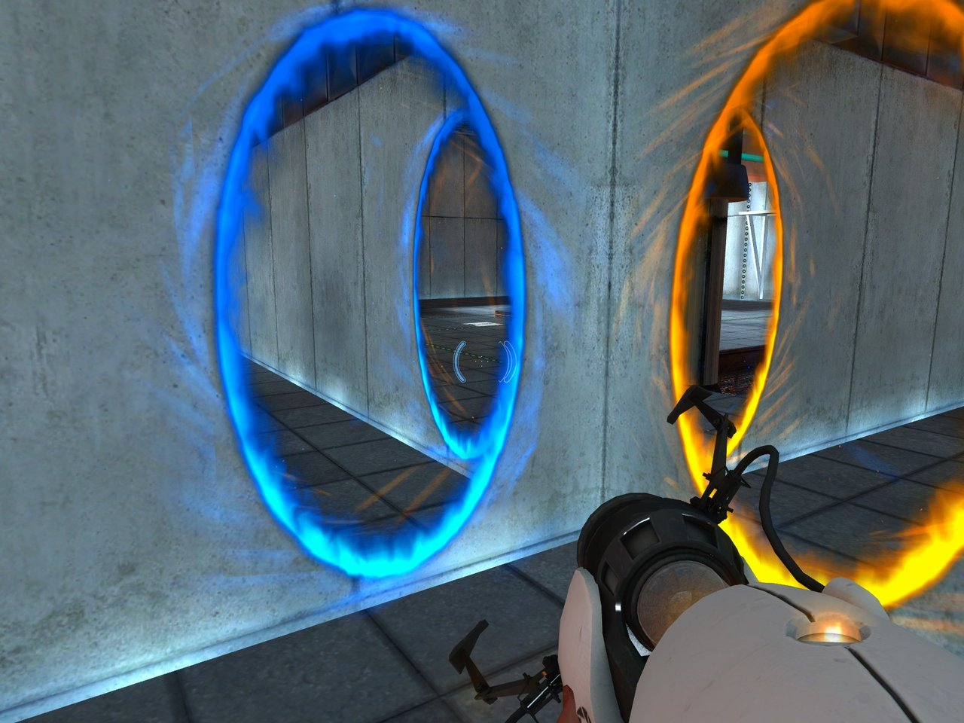
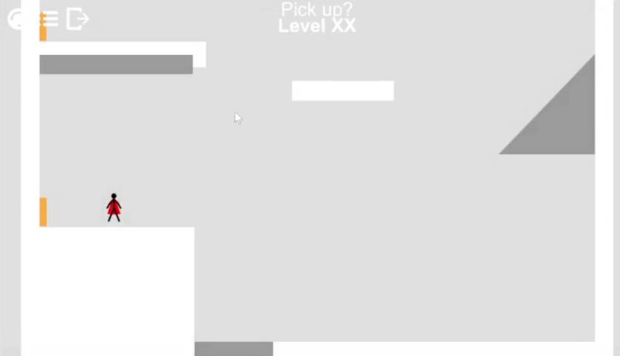
The Classic: “Portal 1 and 2”
Put a spin on the classic: 2D portals!
Portals are fun and have so many possibilities

Slide 5
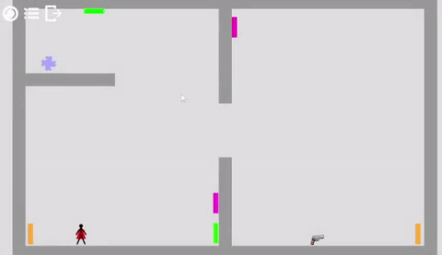
Game play mechanics:
Core mechanic:
1. portals can teleport you from one to the other with speed.
2. you can control two portals at will
3. non-player-controlled-portals can teleport you to one with same color
Goal: go from the start to the finish
Challenge: solve your way through the puzzle

Slide 6
2. Level Design

Slide 7

How to design a GOOD puzzle?
The Assumption
The Catch
The Revelation

Slide 8

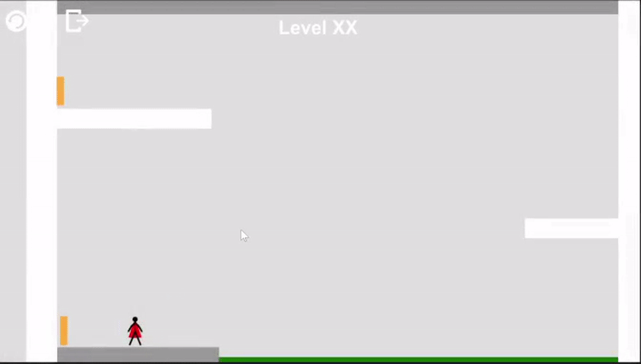
How to design a GOOD puzzle?
The Assumption
The Catch
1. Lure your player to The Assumption thus reveal The Catch

Slide 9
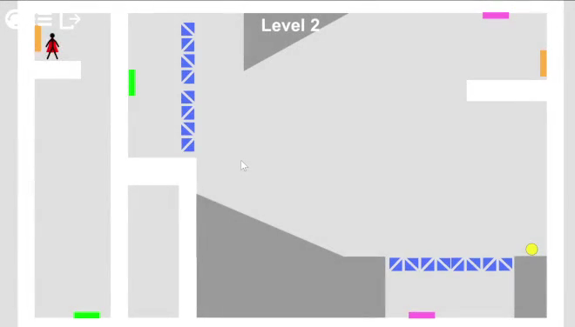
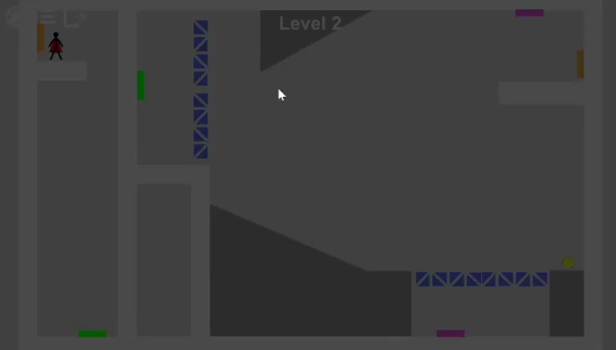
How to design a GOOD puzzle?
The Catch
The Revelation
2. Guide you player from The Catch to The Revelation

Slide 10
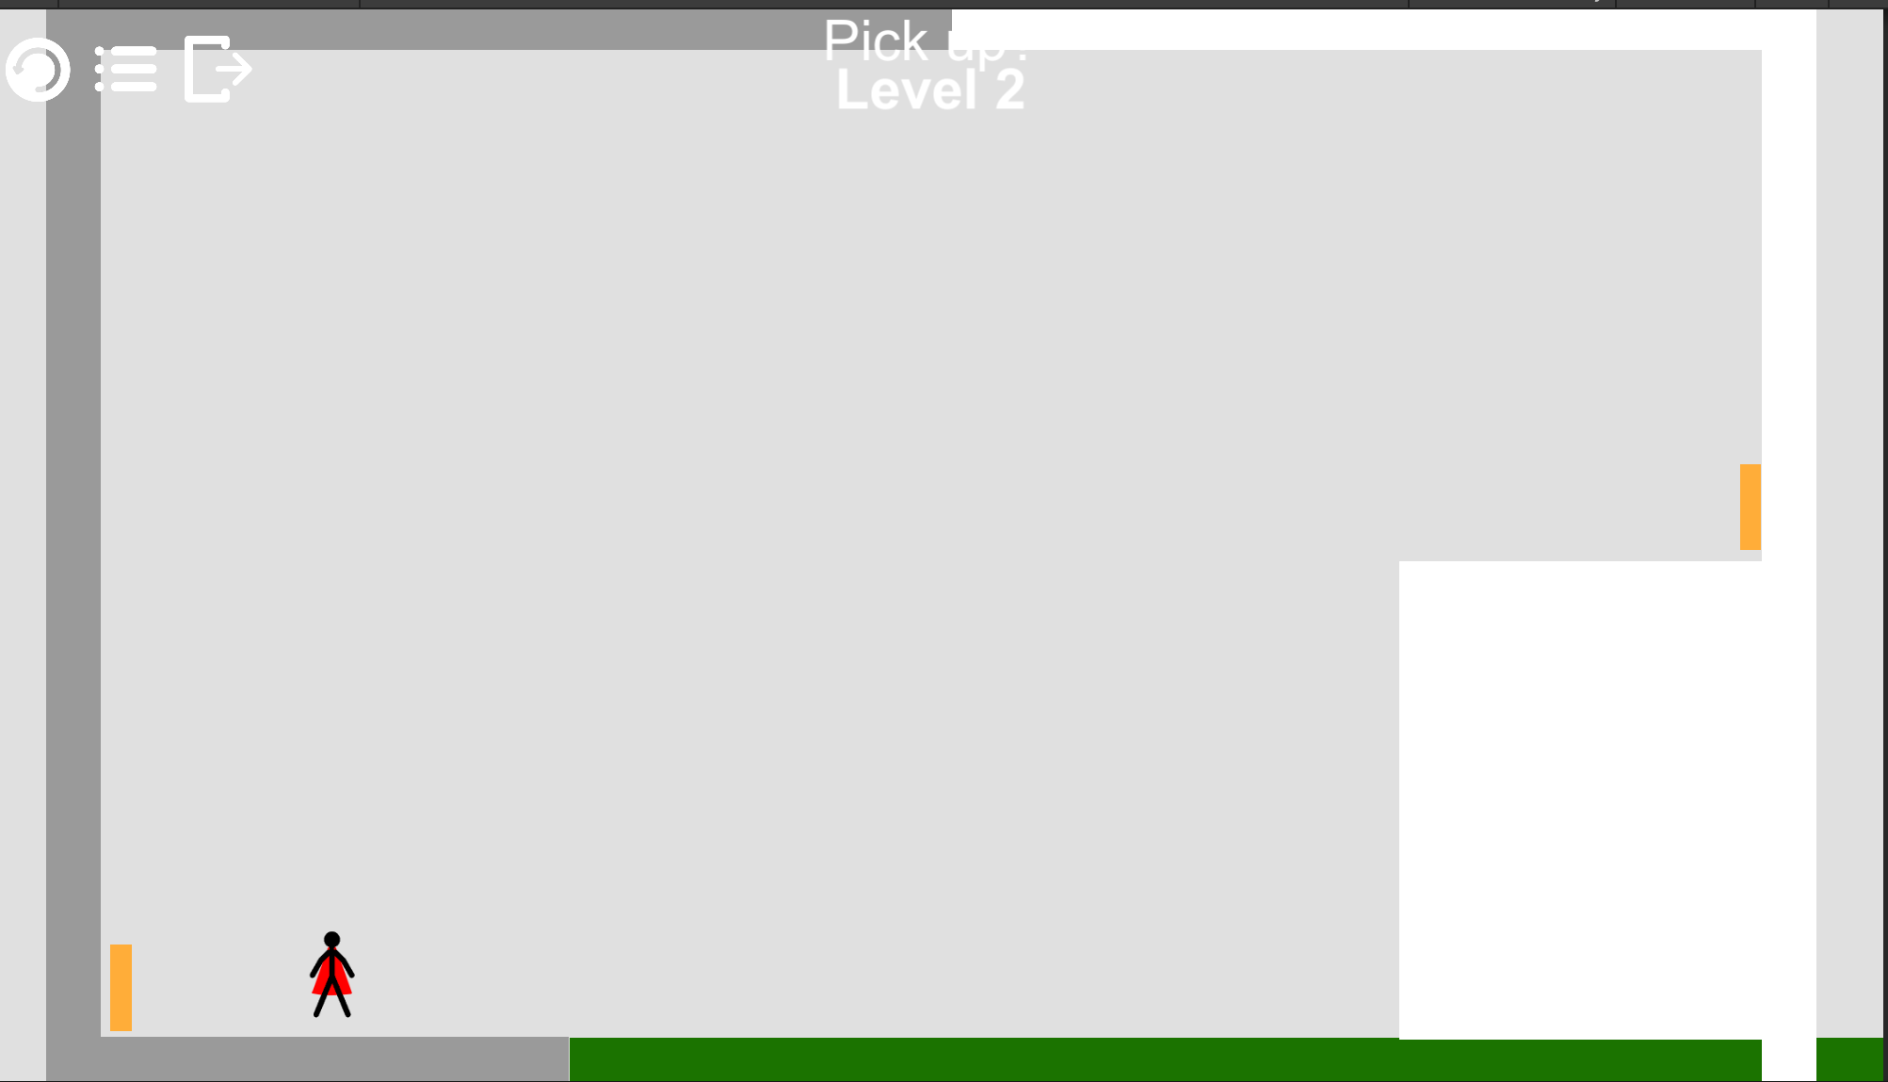
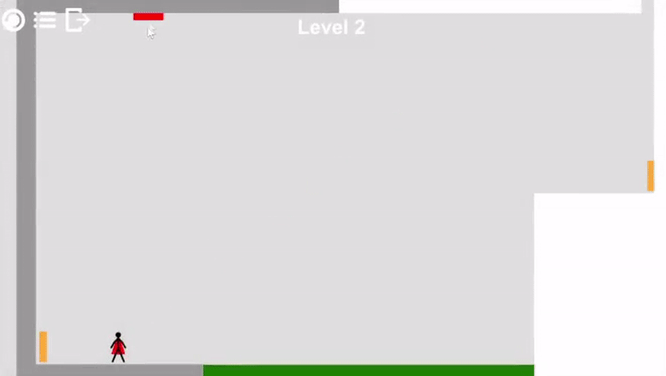
How to design a GOOD puzzle?
The Catch
The Revelation
2. Guide you player from The Catch to The Revelation
What if the revelation is something the player didn’t know that he/she can do?

Slide 11
How to design a GOOD puzzle?
The Catch
The Revelation
3. Set up the Revelation
(don’t make player feel: “I didn’t know I could do that!”)

Slide 12
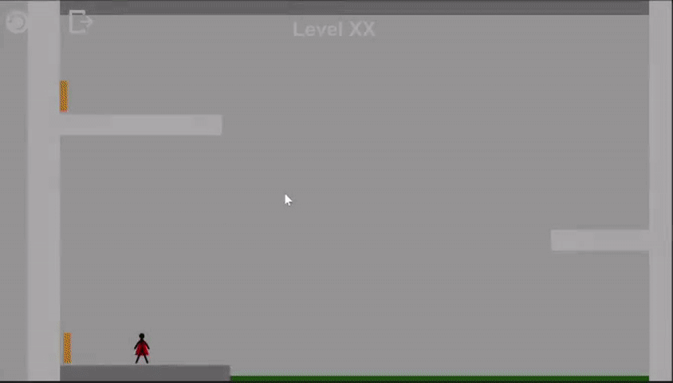
How to design a GOOD puzzle?
The Catch
The Revelation
3. Set up the Revelation before head
(don’t make player feel: “I didn’t know I could do that!”)

Slide 13
How to design a GOOD puzzle?
Set up your revelation
The Revelation
Guide players to the revelation
The Catch
Lure players to wrong assumptions
The Assumption

Slide 14
The End of the Game?
The second way

Slide 15
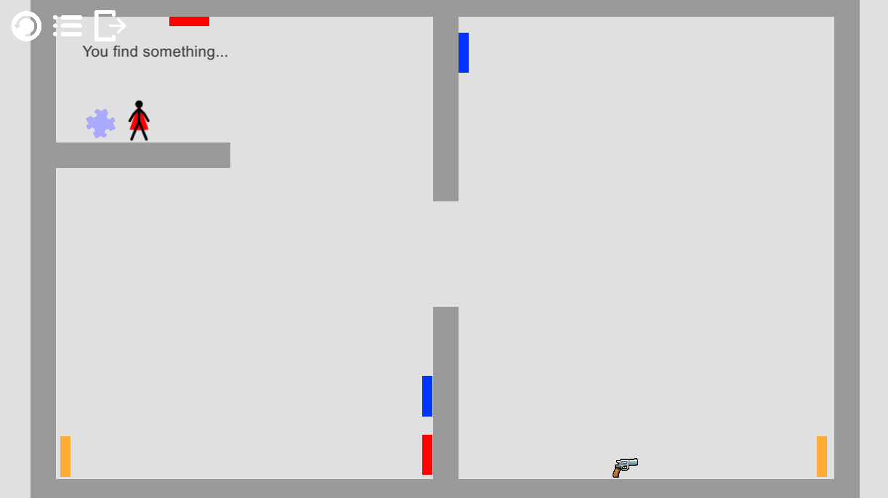
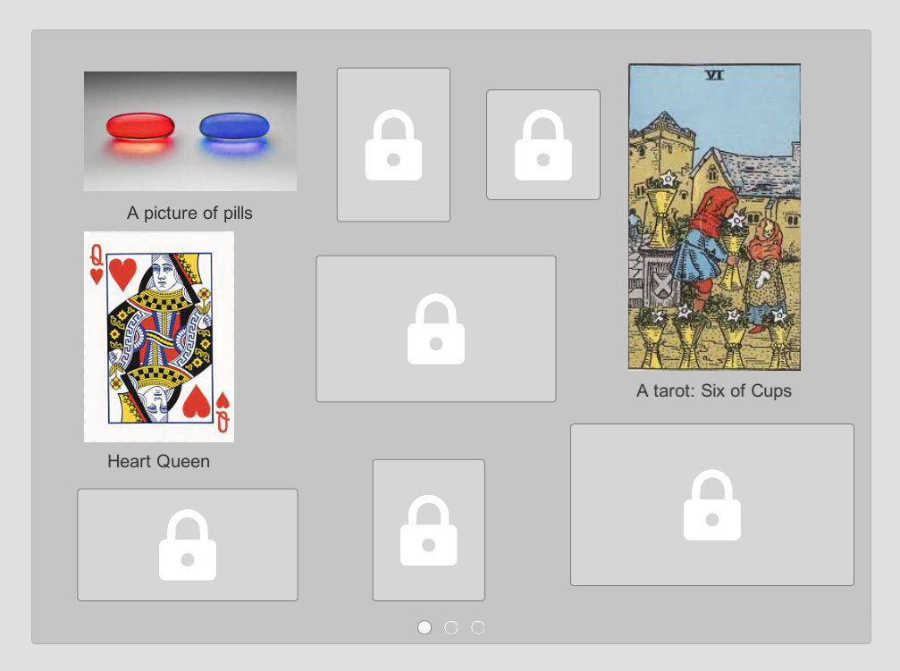
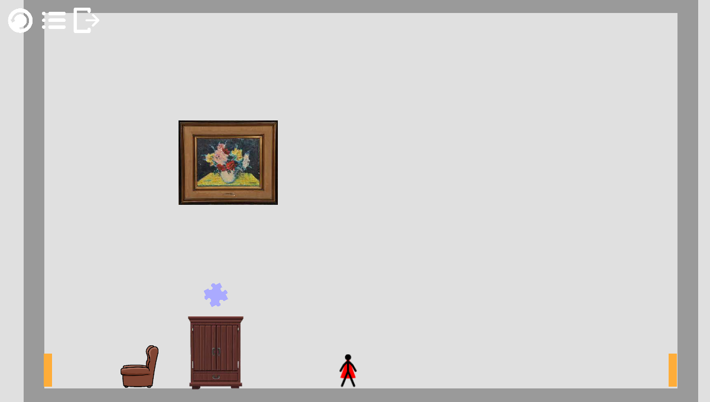
The Second Way
What is the second way of this game?
The second way of playing the game -> collecting memory pieces
Collect the memory pieces in the levels
True end hides in the start level
Memory pieces gallery

Slide 16
The Second Way
2. The second way & the storyline
The second way of playing the game -> helps player uncover the hidden storyline
Storyline structure

Slide 17
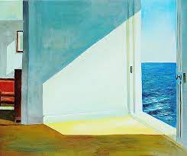
The Second Way
3. The second way & the meaning of the painting
* 2 ways of the game:
first way (go through levels) -> dream, illusion
second way (collecting memory pieces) -> reality
* The painting:
left side: reality
right side: dream
reality
dream

Slide 18
The Second Way
4. The second way: other benefits
Players: Buy 1 game, play 2 games
The game: Include story to entertain those who loves story in game
Future work: potential to add DLC or the next episode

Slide 19
What’s next…
Level Editor

Slide 20
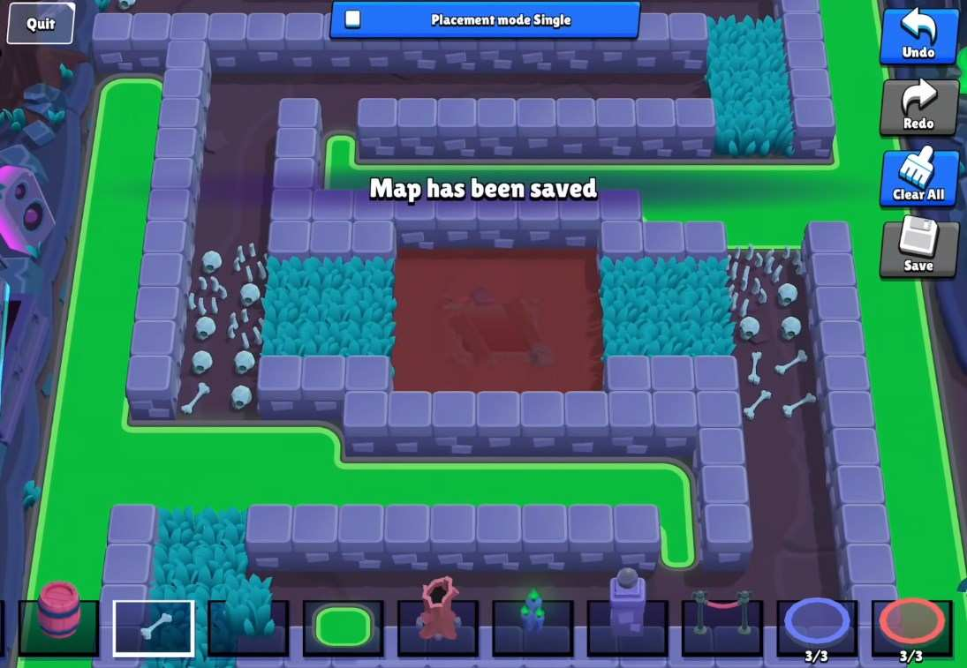
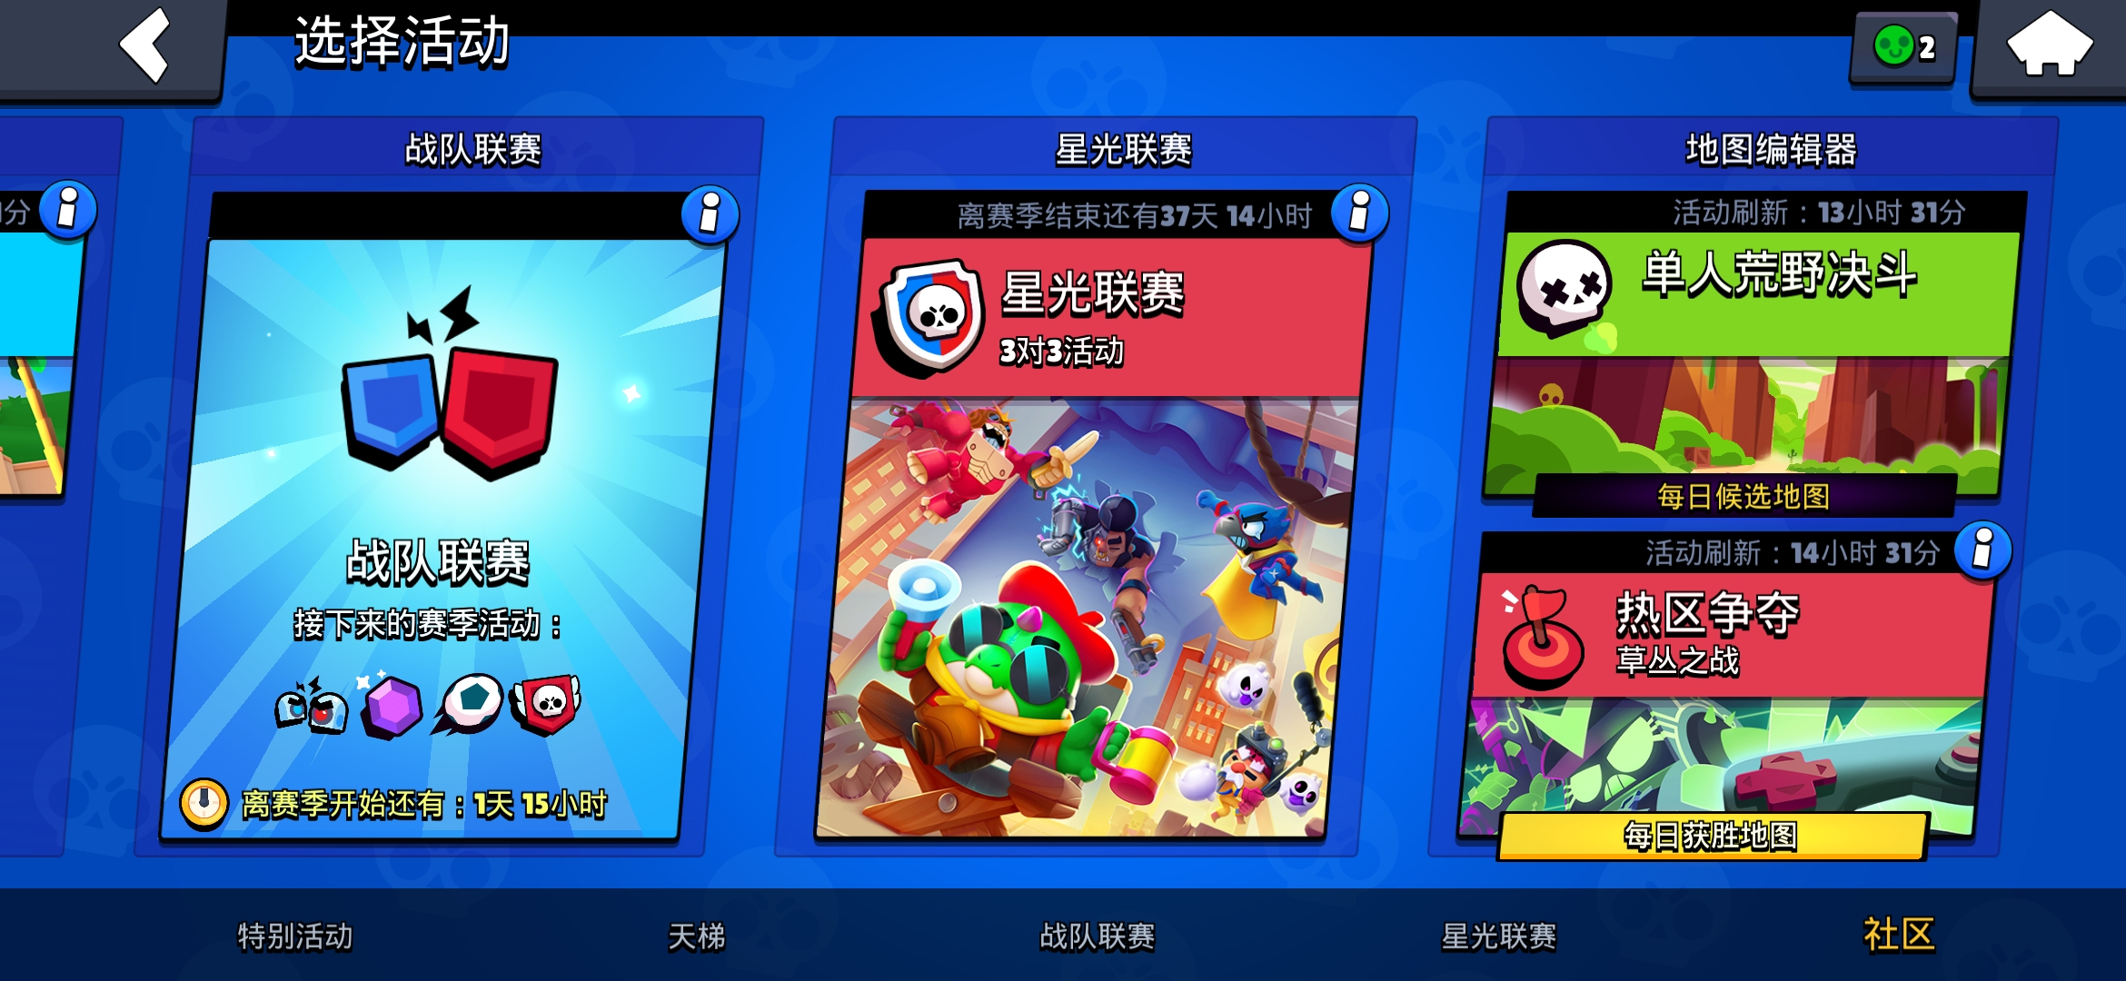
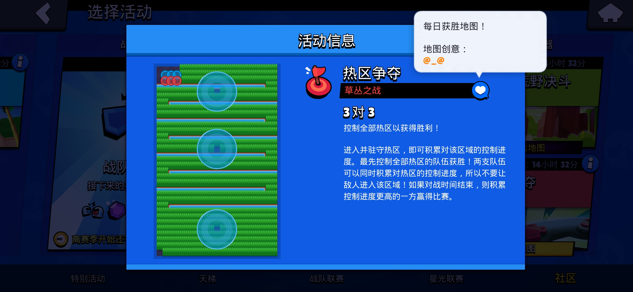

Why Level Editor?
Brawl Stars (荒野乱斗)

Slide 21
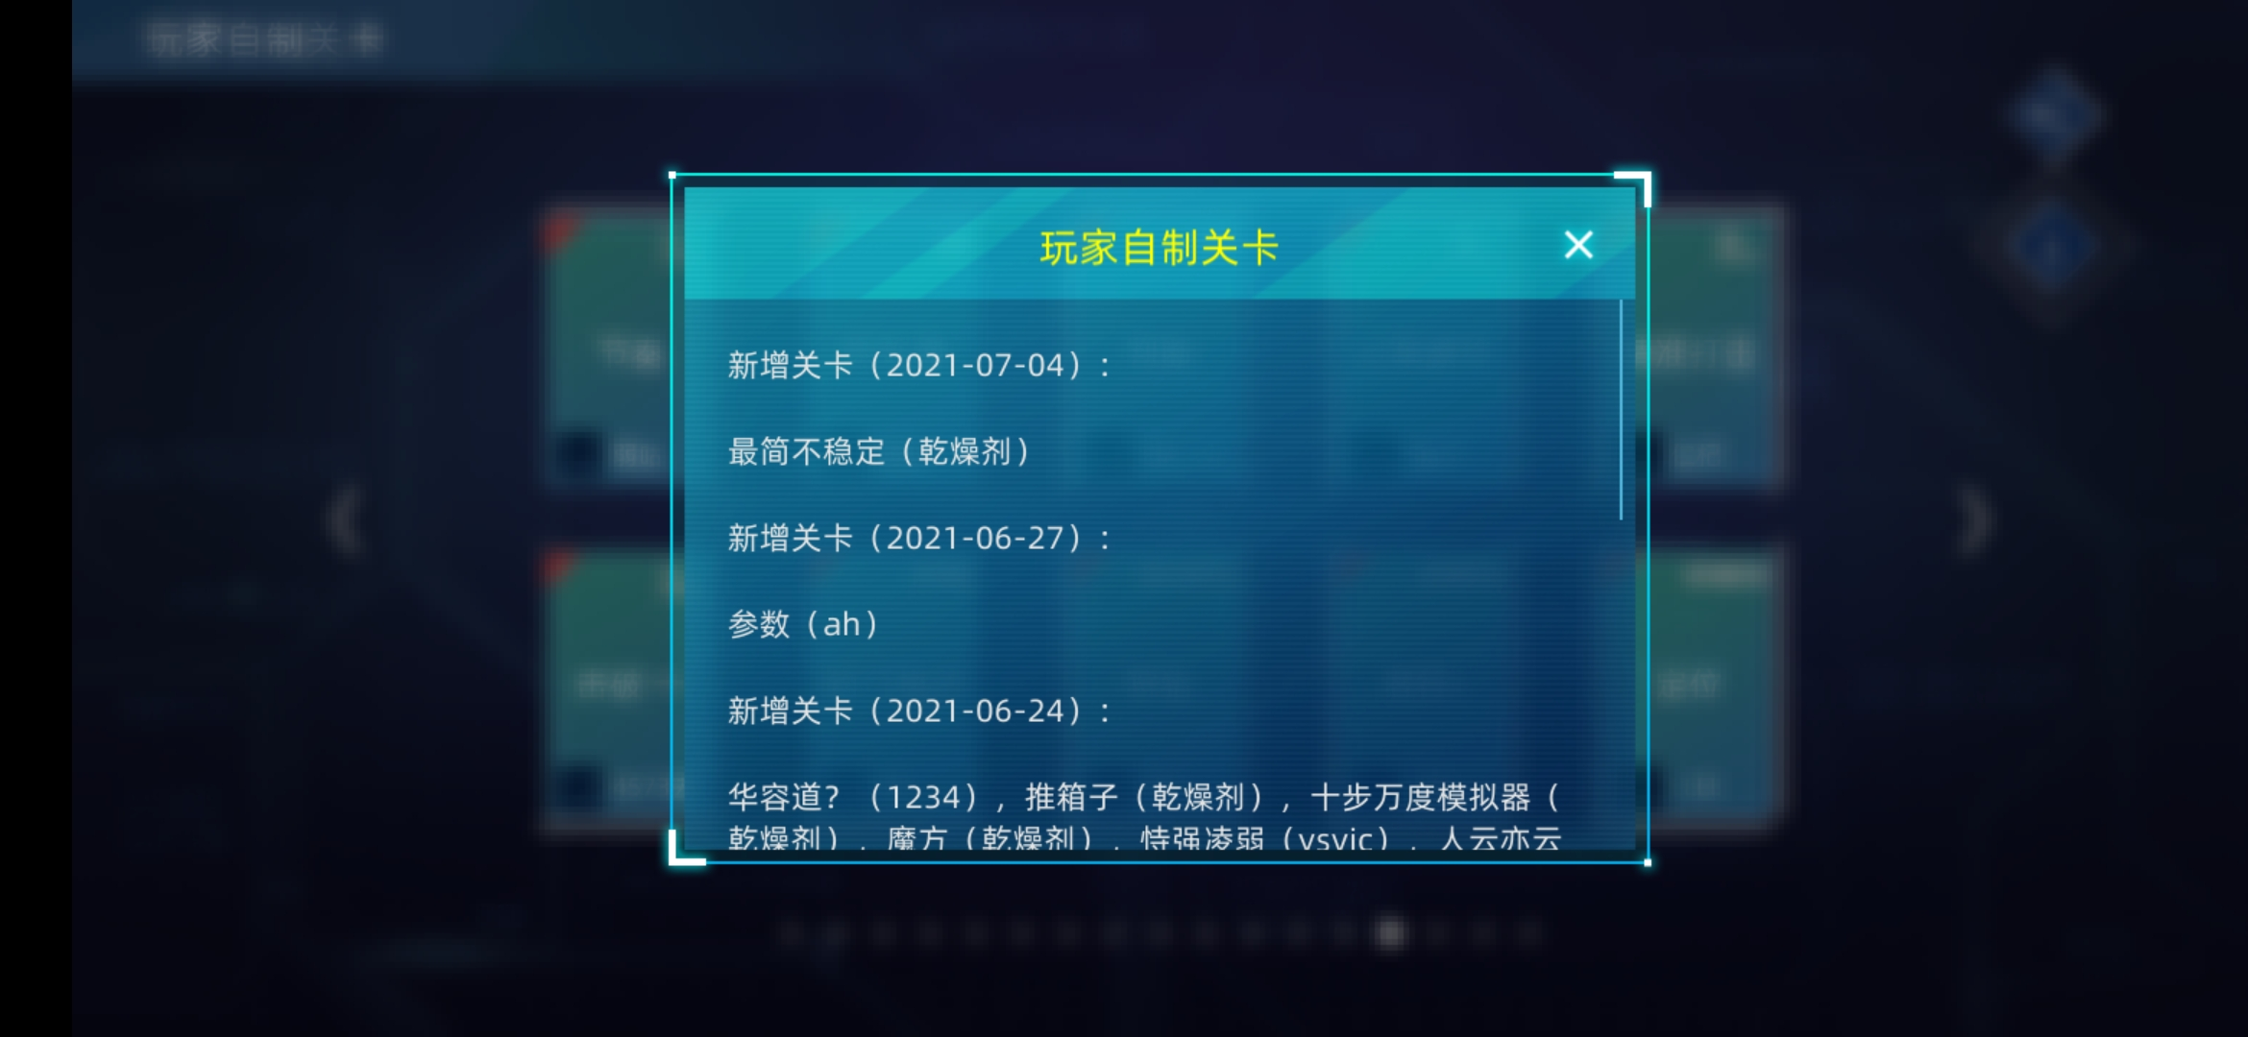
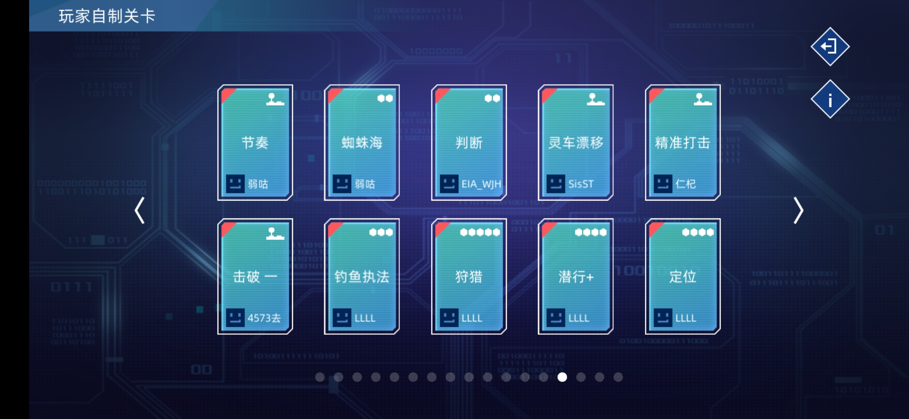
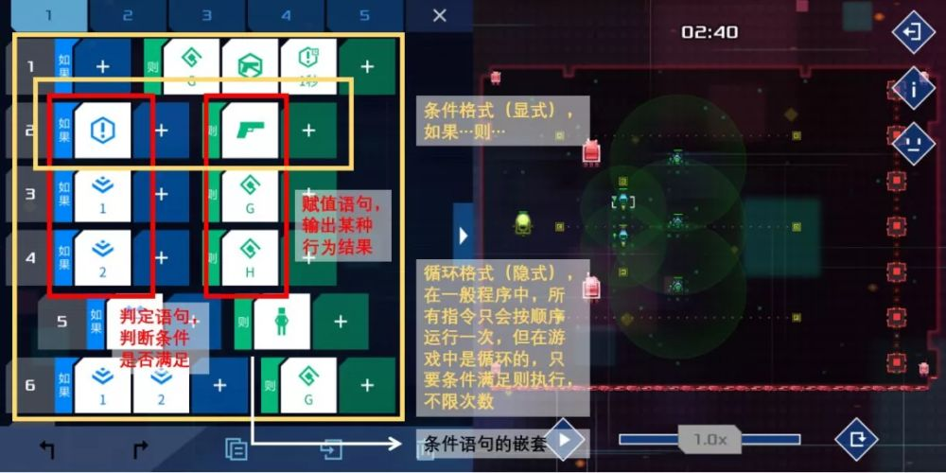
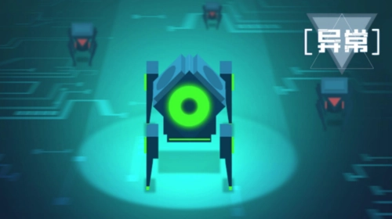
Why Level Editor?
Exception (异常)
Only 30 official levels
Hundreds of player-made levels
Single game released in 2017
Still active in 2021

Slide 22

Why Level Editor?
Freedom
Simple
Modulization

Slide 23
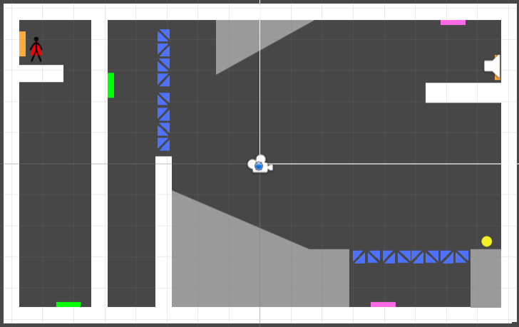




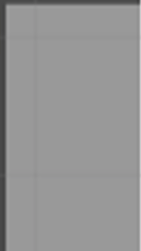
Level Editor - Modulization

Slide 24
Thanks
Design: Zhao Yifan
Program: Hu Yiyan, Chen Honghao
Source code can be found in:
https://github.com/Timothy-197/OneDoorAway

Slide 25
Thank you !

